Slide 1
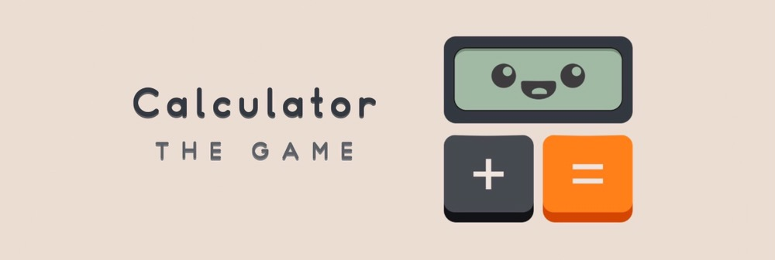
By :-
Tushar Jain
Shubham Jain
Bhavesh Babel

Slide 2
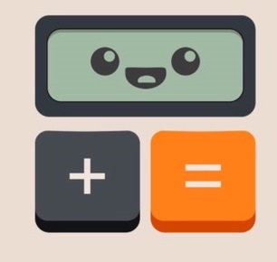
Calculator :The Game
In a world of calculators, one dared to become a game.
Sure, you’ve used calculators before, but have you ever “played” a calculator??
Welcome to Calculator : The Game where you’ll manipulate numbers by adding them, subtracting them, converting them, etc...
FEATURES :-
DISPLAY for extra long equations
COMFORTABLE BUTTONS designed for modern gameplay
SCORE button is given to see the current score

Slide 3
APP COMPONENTS : -
We have used the basic code in creating the game.
We used some variables such as :-
(a) Goal - Aim of player to be achieved by simple calculations.
(b) Move – Chances to achieve the goal (each time value decreases on click ).
Base coding :- Control statement ( switch case, if-else ), Increment – decrement, Relational operator, Arithmetic operator, Logical operator, Bitwise operator.
Android - Java coding :-
(a) XML : - Layout (relative, linear, frame), 3D button , Image View, floating action button . (b) Java :- Switching the activity to other activity (By using Intent), some Android attributes such as OnclickListener, setText etc.

Slide 4
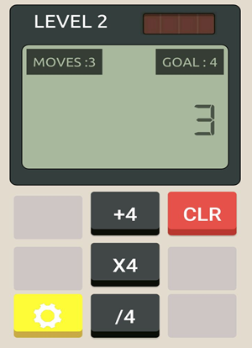
DISPLAY with MOVE button, GOAL button , LEVEL and RESULT
3D Button with respective OPERATIONS

Slide 5


DATASTRUCTURE
SCORE :--
We used data structure in the form of an array to hold the score of each and every level.
Initially, the player will have +10 points, if he uses the CLR button or loose in that level then the point will be deducted by 5.
After completing that particular level, player’s score will be stored in the array and same for all levels.
Finally, on clicking the SCORE button player’s score will be displayed.

Slide 6
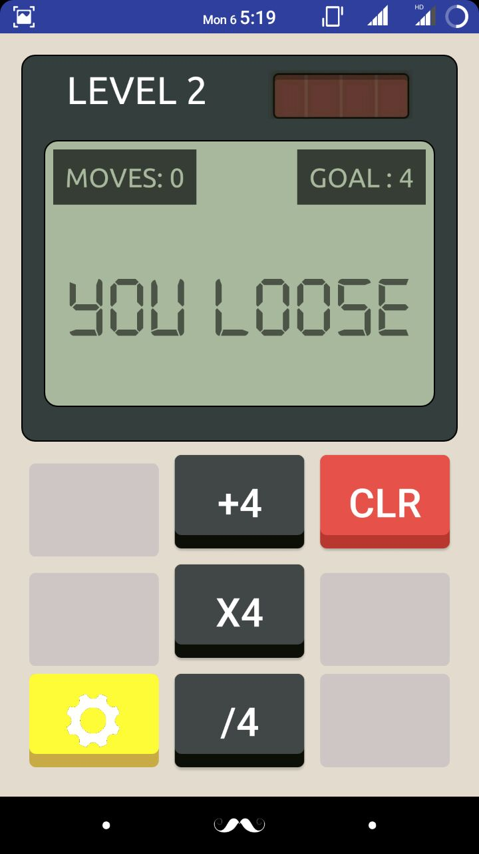
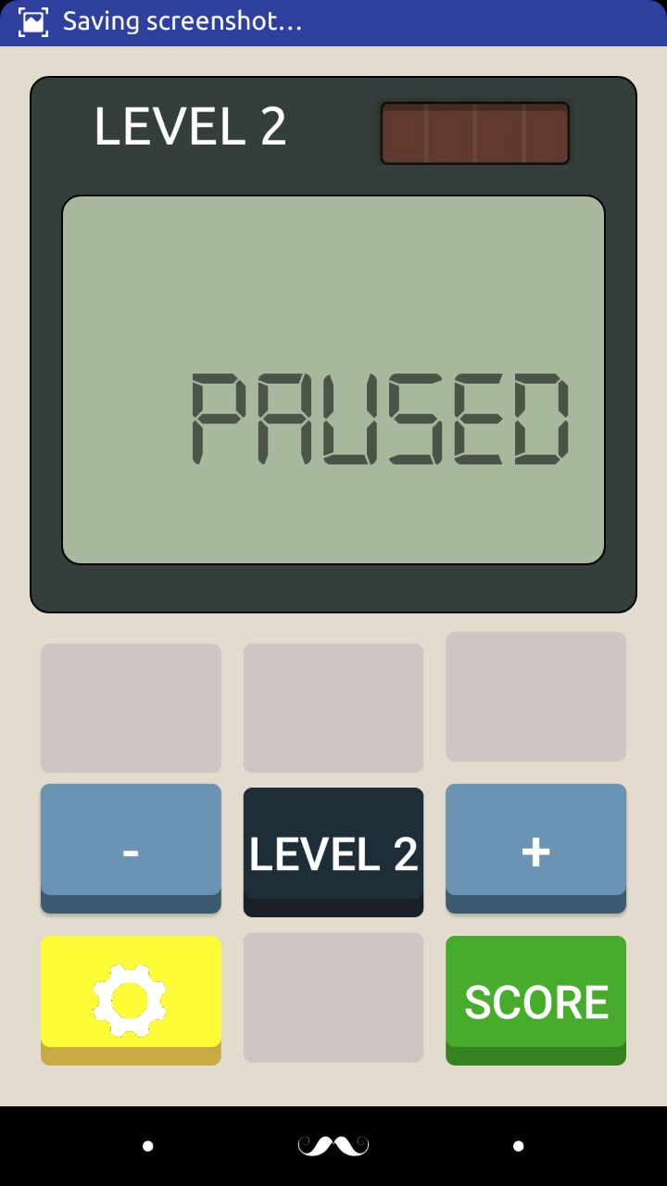
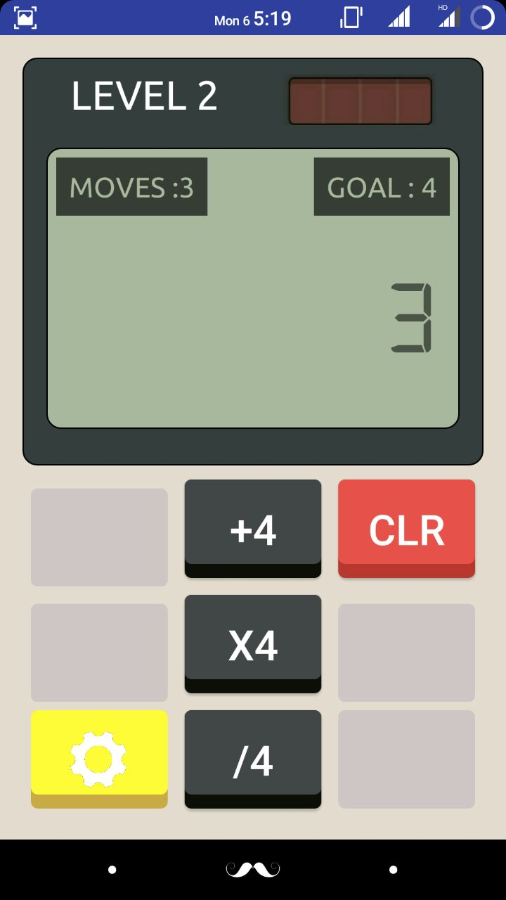
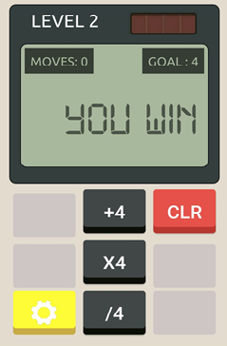
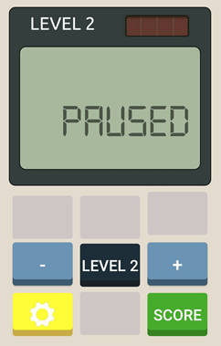
SCORE Button
(displays final Score)

Slide 7
Team feedback
It was a great experience with android.
The best part of the workshop was the team work and opportunity to apply learned knowledge straightaway.
Thank you very much for motivating us.

